Slide 1

Workshop 3
Introduction to Minecraft: Pi Edition

Slide 2
Hello, World!
Python Basics

Slide 3
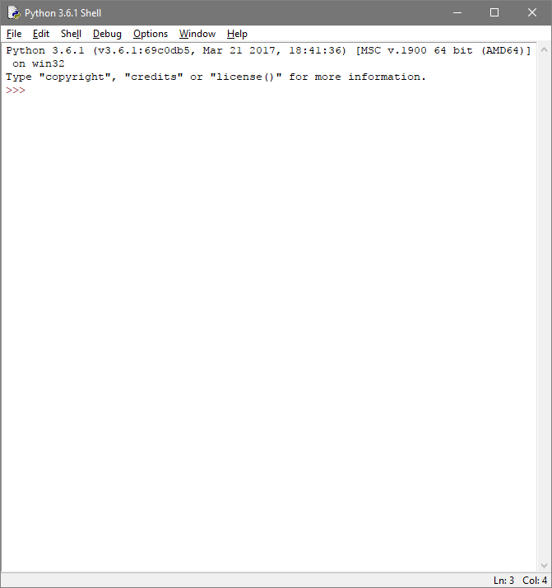
Hello, World!
Open the application menu and find the program called ‘IDLE 3’
Launch IDLE 3. After a few seconds a “Shell” window will open.

Slide 4
Hello, World!
>>> print (“Hello World”)
Hello, World!
>>> while True:
print(“Hello, World!”)
Try typing the following code into the shell window
‘>>>’ is a prompt, which means Python is ready to accept a line of code.
The result will be printed after the line is complete.

Slide 5
Hello, World!
>>> print (“Hello World”)
Hello, World!
>>> variable = 5
>>> print(variable)
5
Try typing the following code into the shell window
‘>>>’ is a prompt, which means Python is ready to accept a line of code.
The result will be printed after the line is complete.
A variable is where we store data in our programs. We can give our variables (almost) any name.

Slide 6
Hello, World!
>>> print (“Hello World”)
Hello, World!
>>> variable = 5
>>> print(variable)
5
>>> variable = variable + 8
>>> print(variable)
13
Try typing the following code into the shell window
‘>>>’ is a prompt, which means Python is ready to accept a line of code.
The result will be printed after the line is complete.
A variable is where we store data in our programs. We can give our variables (almost) any name.

Slide 7
Hello, World!
>>> a = 8
>>> b = 4
>>> c = a + b
>>> print(c)
What would be printed if you ran this code?
Have a guess before you run the code yourself!

Slide 8
Quick Recap
What does the print() function do?
What is a variable?
What does the = symbol mean?

Slide 9
Hello, Minecraft World!
In the Minecraft Chat

Slide 10
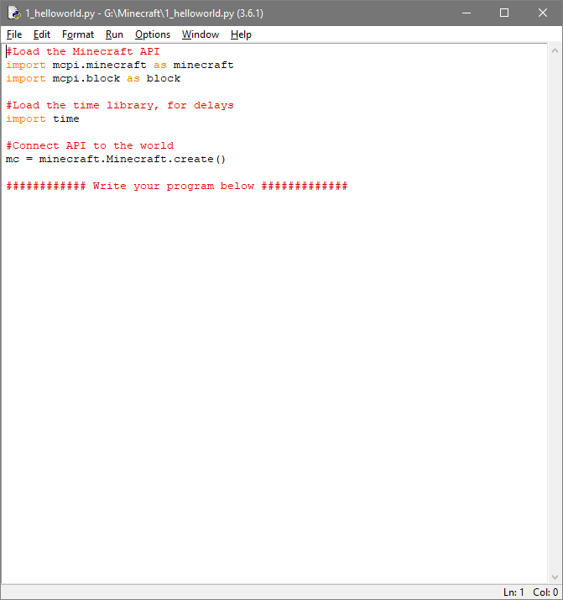
Hello, Minecraft World!
Go to File > Open and open the template Minecraft script: 1_helloworld.py
Make sure you’re typing into the script file (not the shell window) from this point onwards

Slide 11
Hello, Minecraft World!
#Load the Minecraft API
import mcpi.minecraft as minecraft
import mcpi.block as block
#Load the time library, for delays
import time
#Connect API to the world
mc = minecraft.Minecraft.create()
#### Write your program below #####
Don’t Panic! It looks like there’s a lot of code here, but this is all setup code we don’t need to worry about.
Comments are lines beginning with # symbols. They are ignored by Python, so we use them to label our code.
Write your programs below the final comment line.

Slide 12
Hello, Minecraft World!
#Load the Minecraft API
import mcpi.minecraft as minecraft
import mcpi.block as block
#Load the time library, for delays
import time
#Connect API to the world
mc = minecraft.Minecraft.create()
#### Write your program below #####
mc.postToChat(“Hello, World!”)
Add the following line to print to the Minecraft chat
print() prints to the Python console output only, so we need to use...
postToChat(), which prints to the Minecraft chat
Try running your program using Run > Run Module
Minecraft must be running and in world

Slide 13
Midas Touch
Changing a Block

Slide 14
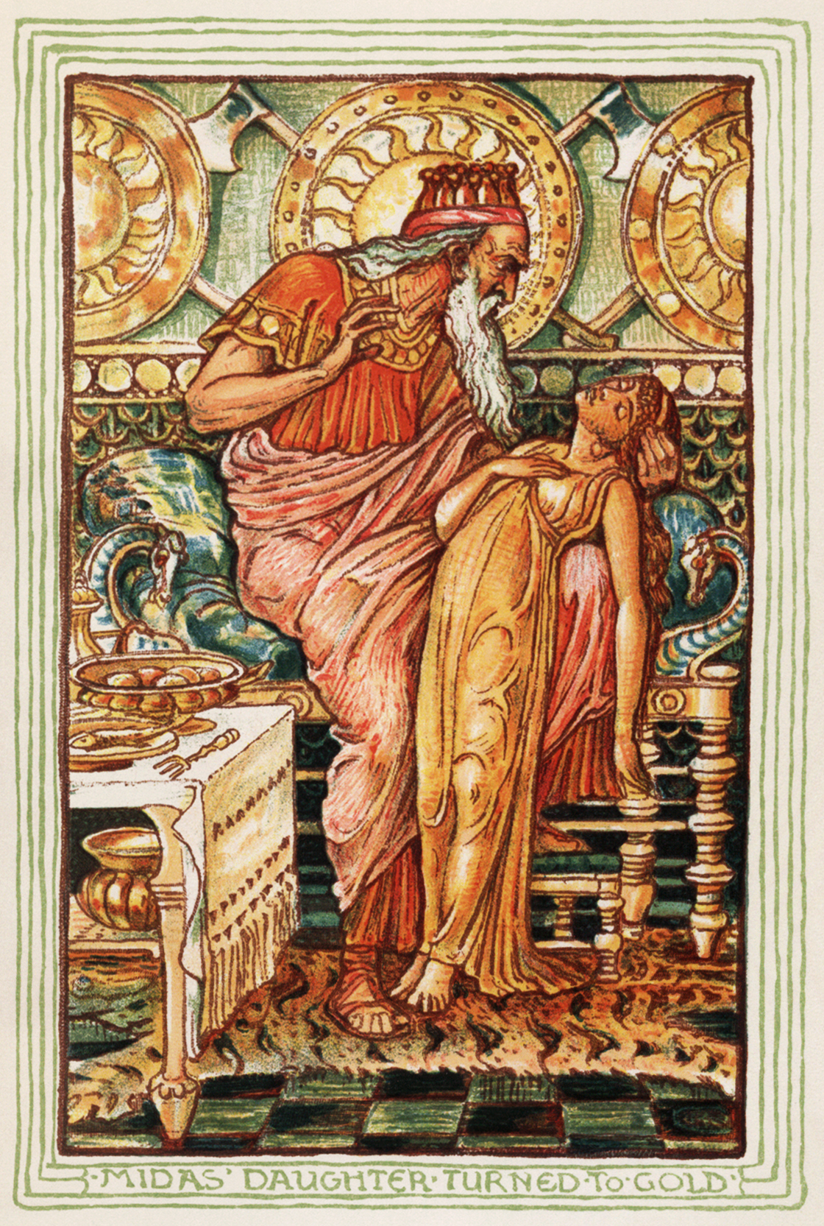
Midas Touch
In Greek mythology, King Midas turned everything he touched into gold
Let’s do the same thing in Minecraft

Slide 15
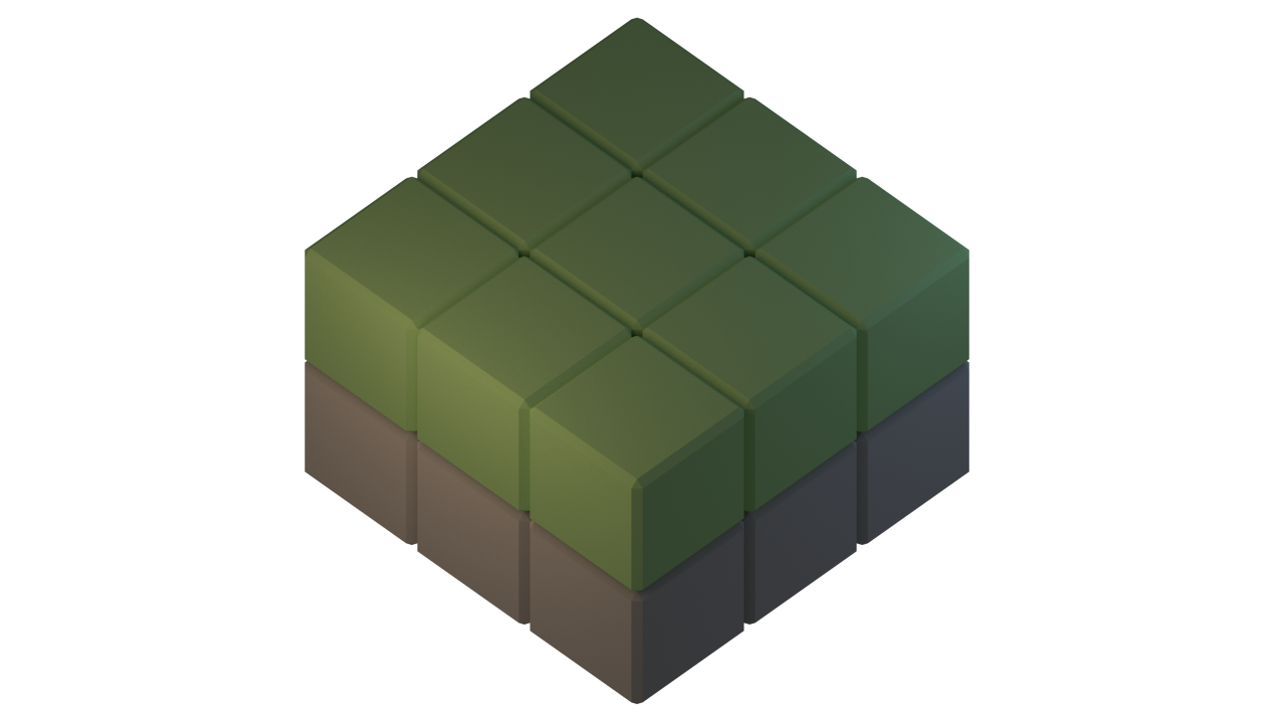
What do we want to do?

Slide 16
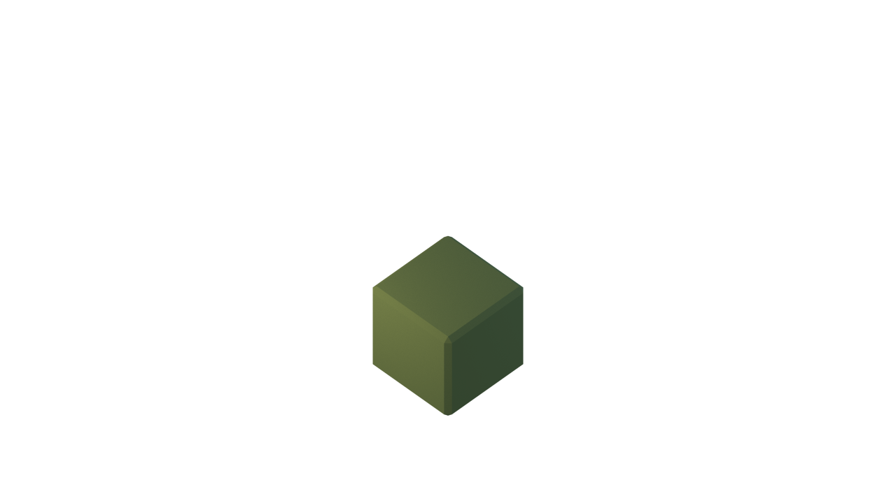
What do we want to do?

Slide 17

What do we want to do?

Slide 18
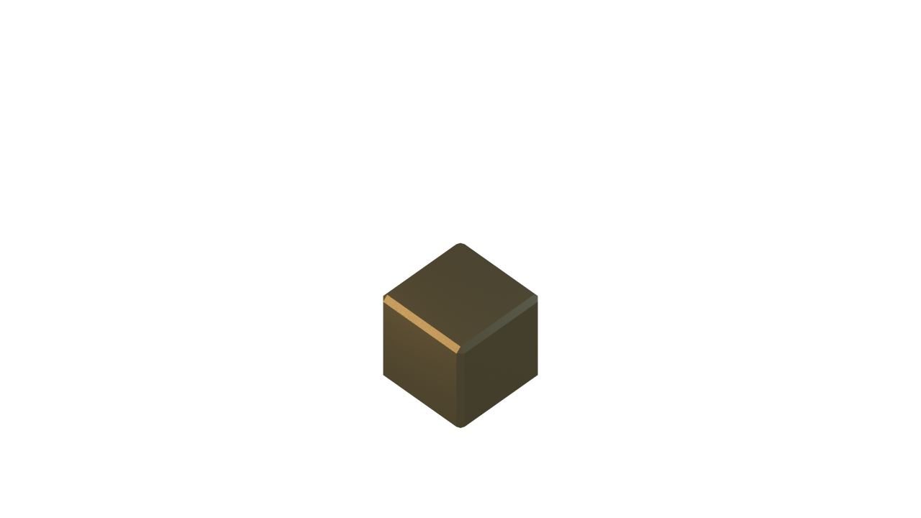
What do we want to do?

Slide 19
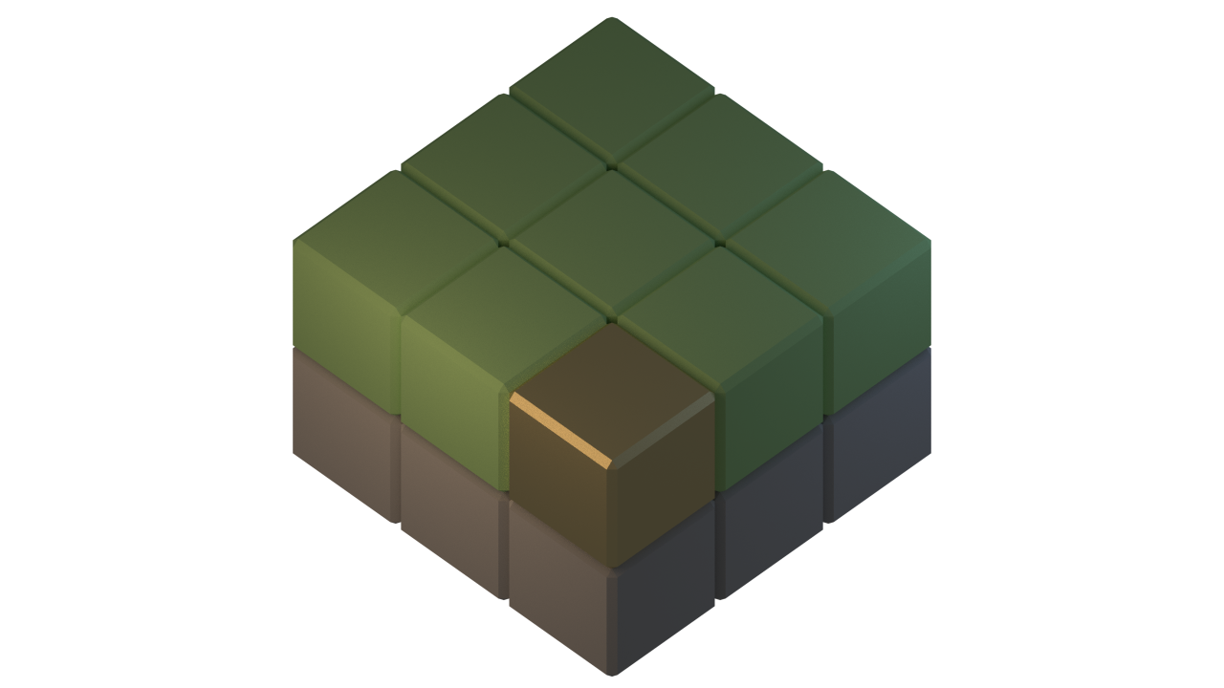
What do we want to do?

Slide 20
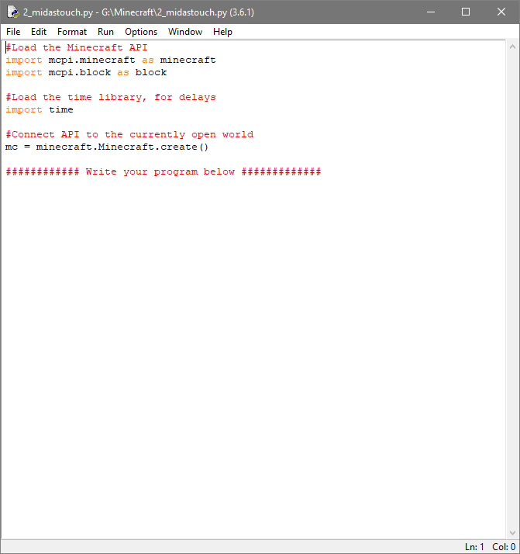
Midas Touch
Go to File > Open and open the template Minecraft script: 2_midastouch.py

Slide 21
Midas Touch
#### Write your program below #####
# Get the player position
position = mc.player.getTilePos()
Go to File > Open and open the template Minecraft script: 2_midastouch.py
Add the following line to store the player’s position
The brackets () mean that we are calling a function, which is a bit of code that has been written for us.

Slide 22
World
Player
Blocks
Tile position
z
y
x
Getting the Player Position

Slide 23
Coordinates Demo

Slide 24
Midas Touch
#### Write your program below #####
# Get the player position
position = mc.player.getTilePos()
# Change the block to gold
mc.setBlock(position.x, position.y, position.z, block.GOLD_BLOCK)
Go to File > Open and open the template Minecraft script: 2_midastouch.py
Add the following line to store the player’s position
The brackets () mean that we are calling a function, which is a bit of code that has been written for us.
Run your code again, and see what happens

Slide 26
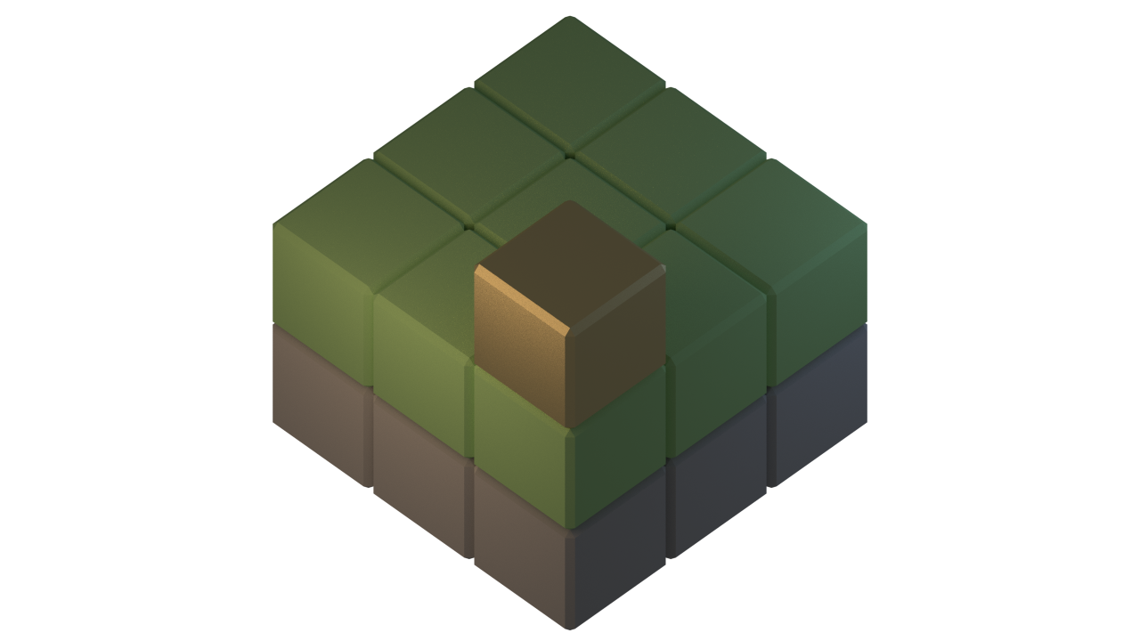

Slide 27
(0, 2, 0)
Y
X
Z

Slide 28
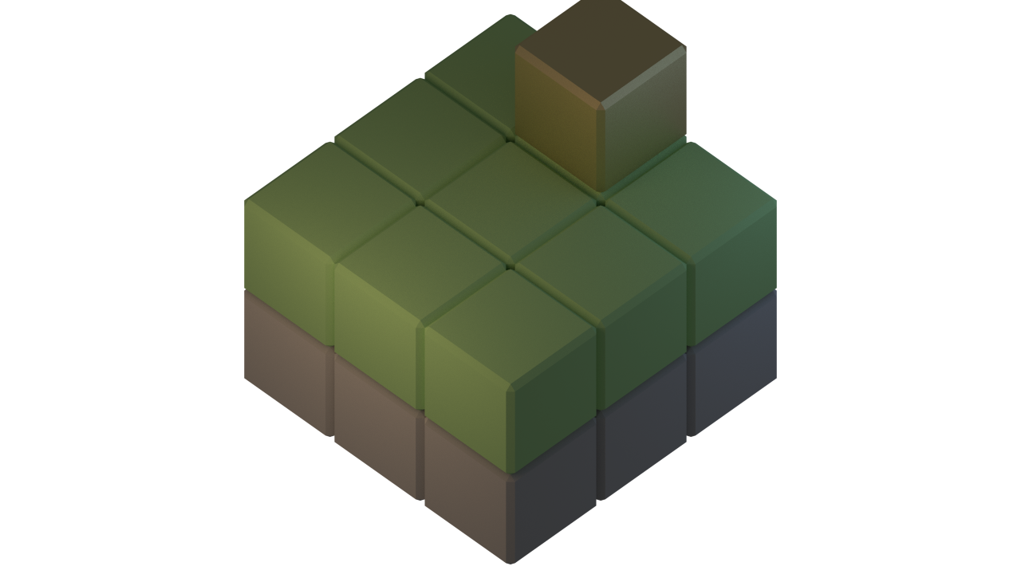
(1, 2, 2)
Y
X
Z

Slide 29
(0, 2, 0)
Y
X
Z

Slide 30
(0, 1, 0)
Y
X
Z

Slide 31
Midas Touch
#### Write your program below #####
# Get the player position
position = mc.player.getTilePos()
position.y =
# Change the block to gold
mc.setBlock(position.x, position.y, position.z, block.GOLD_BLOCK)
Add a line to decrease the y coordinate by 1

Slide 32
Midas Touch
#### Write your program below #####
# Get the player position
mc.player.getTilePos()
position.y = position.y - 1
# Change the block to gold
mc.setBlock(position.x, position.y, position.z, block.GOLD_BLOCK)
Add a line to decrease the y coordinate by 1
Run your code again, and see what happens

Slide 33
Midas Touch V2
Keep Changing Blocks

Slide 34
Loops
>>> x=0
>>> while x<10:
>>> print(x)
>>> x = x + 1
Run the following code in the Shell Window. (not the midas touch script)

Slide 35
Midas Touch
#### Write your program below #####
while True:
# Get the player position
mc.player.getTilePos()
position.y = position.y - 1
# Change the block to gold
mc.setBlock(position.x, position.y, position.z, block.GOLD_BLOCK)
If we encase our code in an infinite loop, we will keep changing blocks to gold until we stop the script
Ensure the indentation is correct inside the loop
Run your code again, and see what happens

Slide 36
Midas Touch V3
Don’t Change the Air

Slide 37
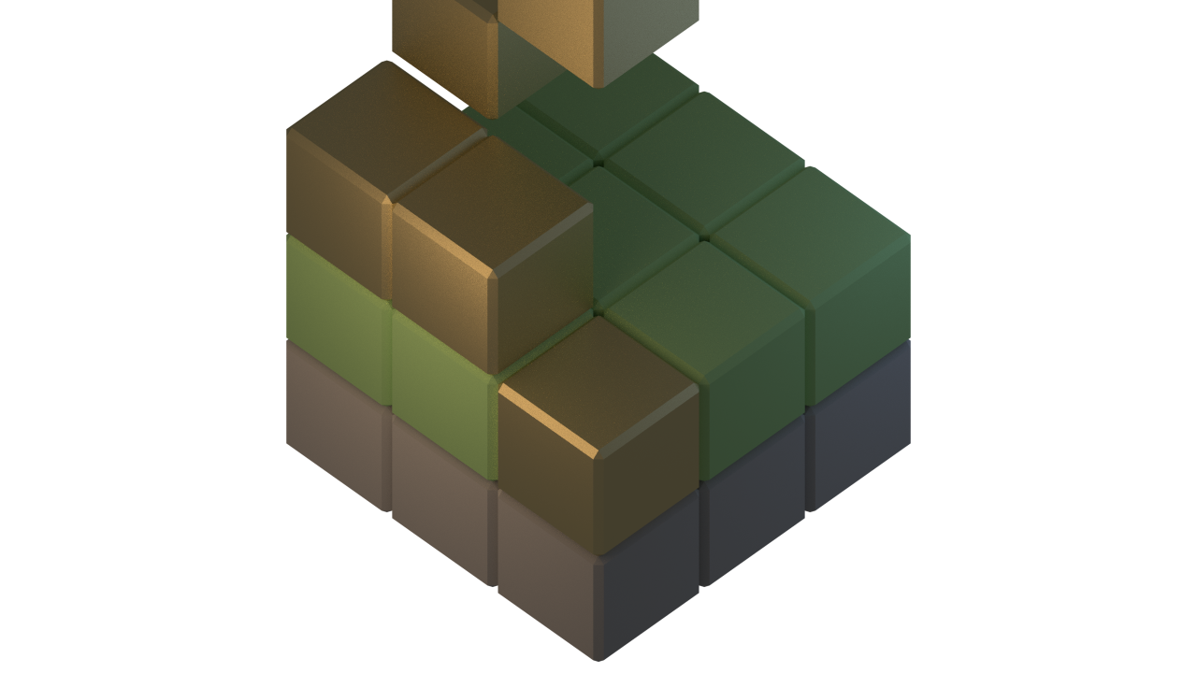

Slide 38
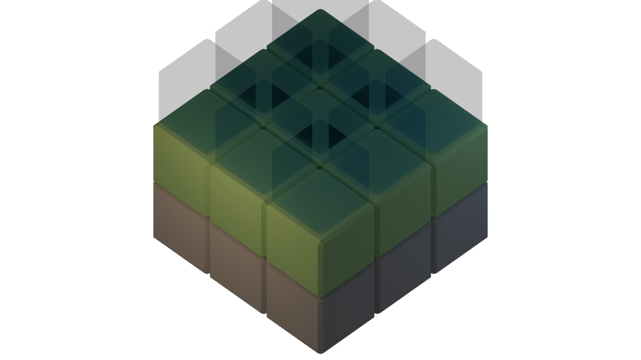

Slide 39
Comparisons
>>> x = 0
>>> x > 4
False
>>> x <= 1
True
>>> x != 7
True
>>> x == 13
False
Run the following code in the Shell Window. (not the midas touch script)
Watch out! A single = is a variable assignment, a == is an equals comparison.

Slide 40
Midas Touch
# Get the player position
mc.player.getTilePos()
position.y -= 1
# Get the type of block
block_type = mc.getBlock(position.x, position.y, position.z)
# Change the block to gold
if( ):
mc.setBlock(position.x, position.y, position.z, block.GOLD_BLOCK)
Add a line to get the block type
Also add the following if statement
What comparison needs to go inside the brackets?

Slide 41
Midas Touch
# Get the player position
mc.player.getTilePos()
position.y = position.y - 1
# Get the type of block
block_type = mc.getBlock(position.x, position.y, position.z)
# Change the block to gold
if( block_type != block.AIR):
mc.setBlock(position.x, position.y, position.z, block.GOLD_BLOCK)
Add a line to get the block type
Also add the following if statement
What comparison needs to go inside the brackets?

